Slide 1
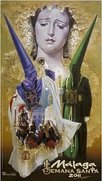
Semana
Santa
en
España

Slide 2
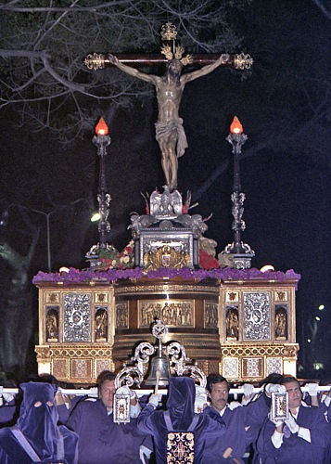
What is Semana Santa?
Semana Santa (or Holy Week) is the Spanish name for Easter. It dates back to the 16th century when the Church decided to present the story of the Passion of Christ in a way that the average person could understand. It was decided that the best way to do this would be a series of processions through the streets, depicting scenes from the story of the fall and rise again of Jesus Christ.

Slide 3
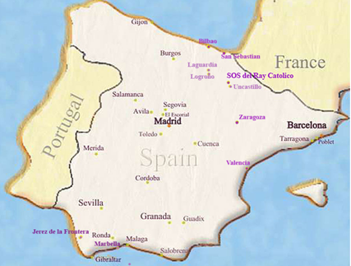
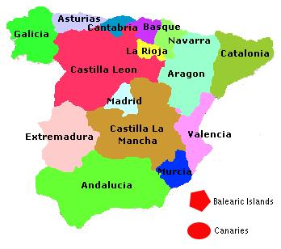
Where is Semana Santa celebrated?
The celebration of Semana Santa is most extravagant in Andalusia, Especially in the cities of Sevilla and Málaga although any Spaniard who is not from Andalusia will tell you that Andalusia's version is not the true Semana Santa. They will tell you that the true Semana Santa is in the region of Castilla-Leon - in particular Zamora and Valladolid, but also in Salamanca, Avila and Segovia. Toledo is also a major focal point for Semana Santa and is the nearest Semana Santa city to the capital of Spain, Madrid.

Slide 4
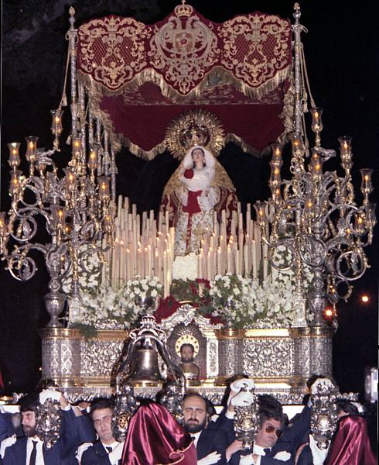
On each day of the Holy week there are various processions, from each brotherhood, hermandad or cofradía, in the city. These botherhoods originated mostly in the 16th and 17th centuries. Being a member of a cofradía used to mean you were at least a pillar of society and very possibly a rich man. The largest cofradía in Seville, the Gran Poder, has over 2,000 members

Slide 5
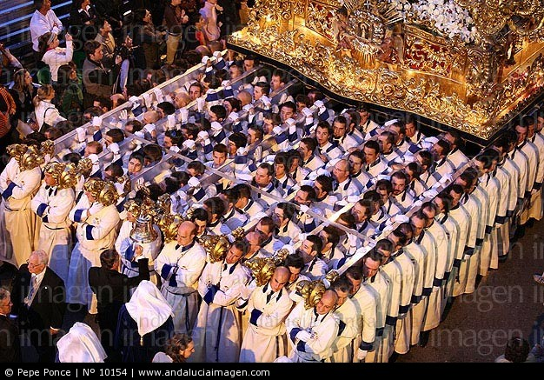
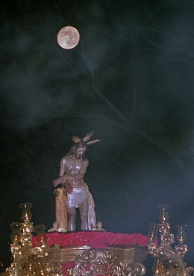
Ornate floats, pasos or tronos are carried from their church to the cathedral and back again. Many brotherhoods carry two floats, one with Christ and one with his mourning mother, Mary the Virgin. The best floats, many decorated in gold and silver, date back to the 16th and 17th centuries and can still be seen today.

Slide 6
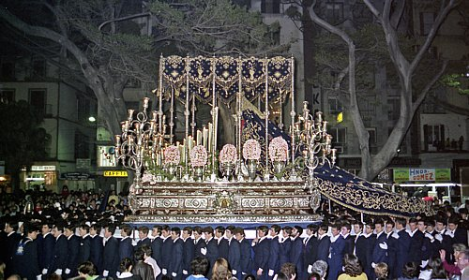
The floats weigh a lot, especially the floats that are carried in Andalusia. It takes many strong men to carry the pasos or tronos through the streets for hours. These men who are honored to experience the pain and participate in the processions are called costaleros.

Slide 7
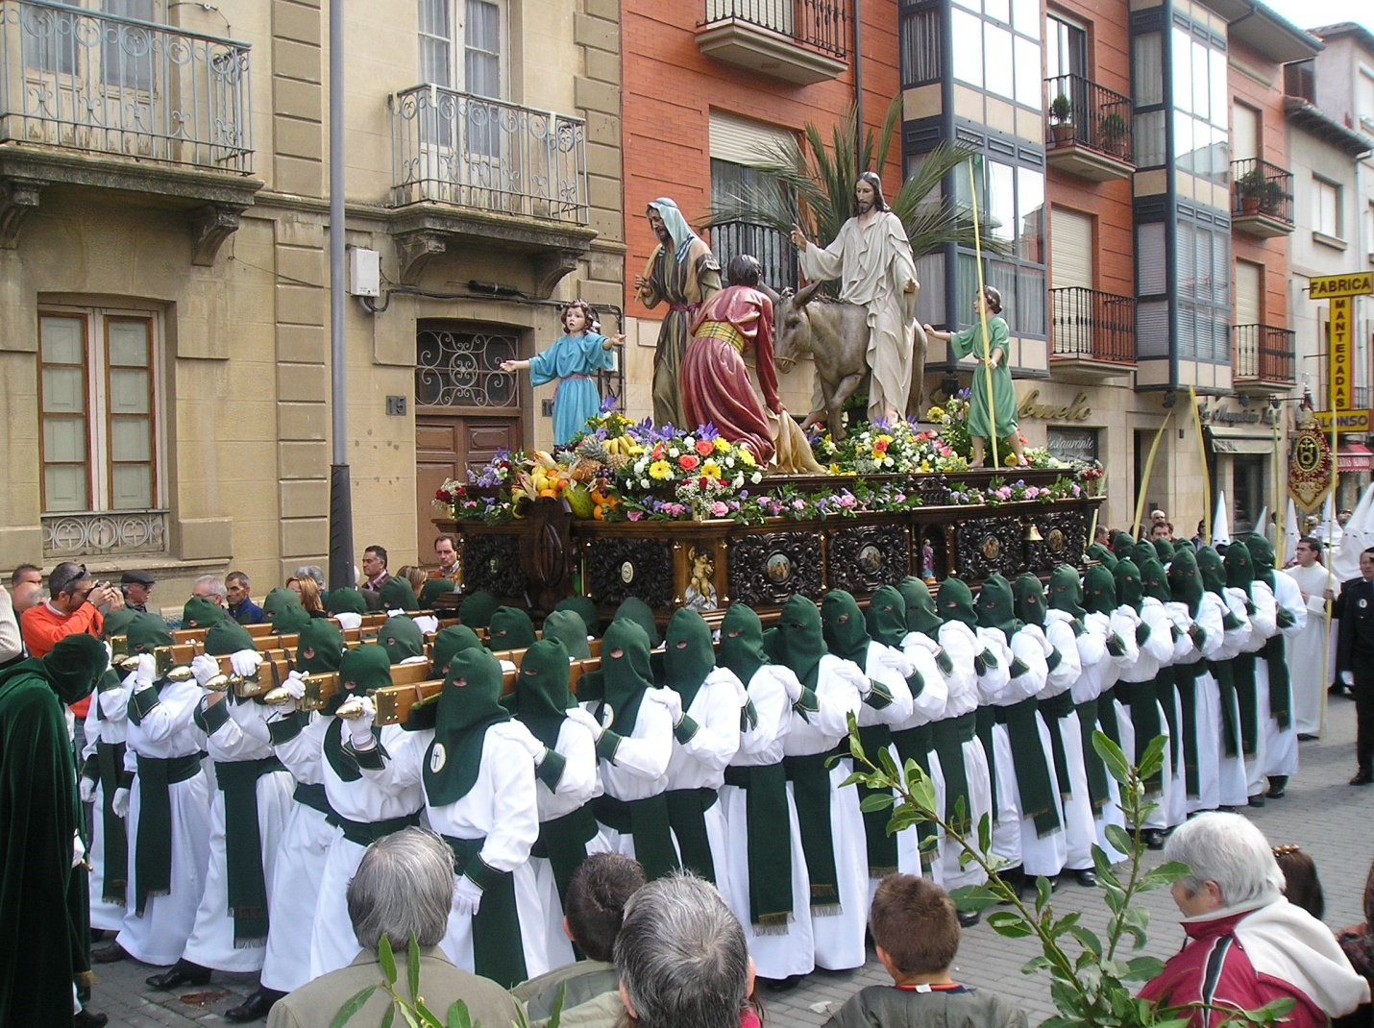
The costaleros survive the long hours and distance carrying the heavy "thrones" because they have a cushion, known as the costal, which prevents the direct contact of the wood rubbing against the skin.

Slide 8
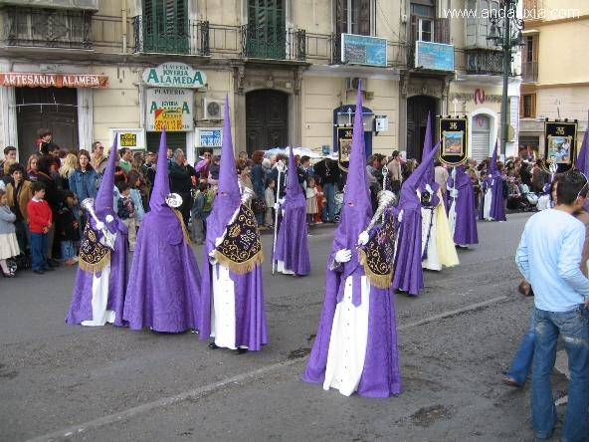
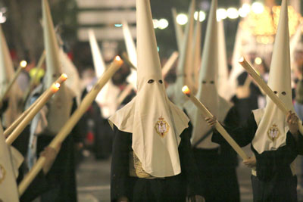
The thrones and costaleros are followed by nazarenos (mostly men and boys) wearing long tunics and masks over their faces to hide their identity, usually draped from high, pointed caps which inevitably remind foreign spectators of the Klu Klux Kan (who copied the idea). These hoods are called capirotes.

Slide 9
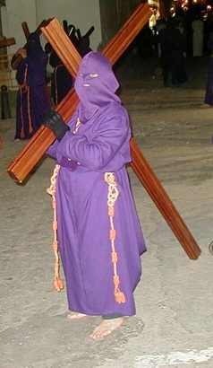
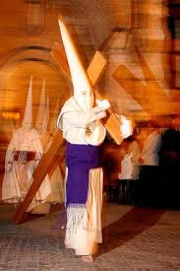
Some nazarenos from particular processions are prohibited from speaking with anyone once dressed in their gown and cap. Penitentes also follow the pasos carrying full-size crosses. In addition, some may follow the route in bare feet, or wearing shackles, even a ball-and-chain: this is because they have made a promesa, a vow. The hood of the Penitentes is called the antifaz.

Slide 10
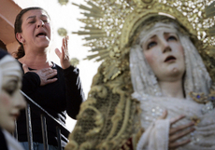
A saeta, an outburst of flamenco song, is an element of Semana Santa particular to the south of Spain. In the old days saetas were spontaneously sung from one of the balconies in the narrow streets of the city. Today they are mainly preplanned and the procession will stop and listen to the song until it is over.

Slide 11
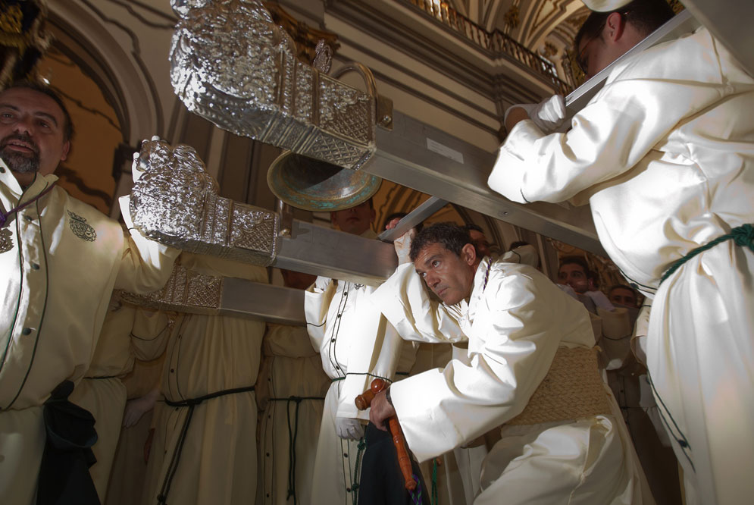
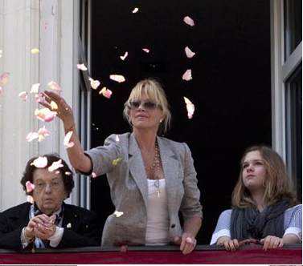
Whether you are a local or a tourist, if you are religious or not, it is difficult not to be moved by the processions.
For some, Semana Santa is a fun filled fiesta time, for others it is a week of ritual and reflection.
Holy Week in Andalucia is a tradition that has been an integral part of the culture for 500 years and which reflects the spirit of the people.

