Slide 1
The immediate future
IR + A + INFINITIVE
Hey…
What are you
GOING TO DO
and
Where are you
GOING TO GO???

Slide 2
To express an action that you “are going to do” in the near future we use the following:
IR + A + INFINITIVE.
Of course we conjugate the verb ir for whoever is GOING TO DO the action.
Do you remember the 6 forms of the verb ir ?

Slide 3
Yo voy
Tú vas
Él va
Ella va
Ud. va
Nosotros vamos
Vosotros vais
Ellos van
Ellas van
Uds. van

Slide 4
Let´s make some sentences
Let´s use the verb estudiar and try to say ¨I am going to study.¨
Using IR + A + INFINITIVE what do we get?

Slide 5
YO VOY A ESTUDIAR
What am I going to do now?

Slide 6
Yo voy a comer.
Yo voy a beber.
Yo voy a cantar.
Yo voy a bailar.
Yo voy a hablar por teléfono.
Yo voy a tocar la guitarra.
Can you say what other subjects are going to do?

Slide 7
Miguel….
Tú….
Tú y yo….
Vosotros…
Las chicas….
Tú y tus amigos..

Slide 8
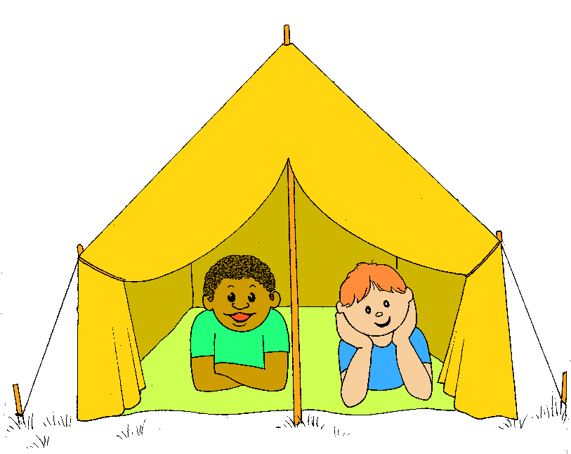
If you want to ask your friend what he/she is going to do you will ask:
¿Qué vas a hacer?
Now ask a friend if he/she is going to do the following?

Slide 9
If you want to know where your friend is GOING TO GO you ask:
¿Adónde vas a ir?
And the answer is……

Slide 10
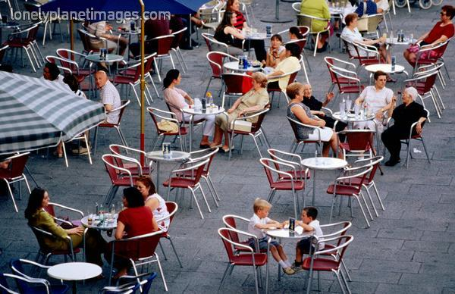
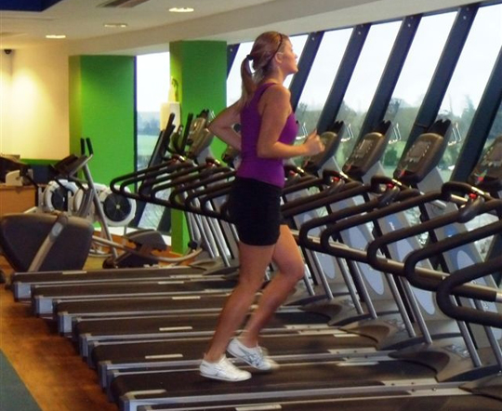
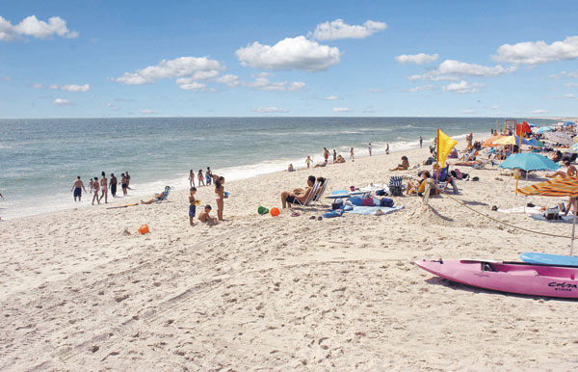
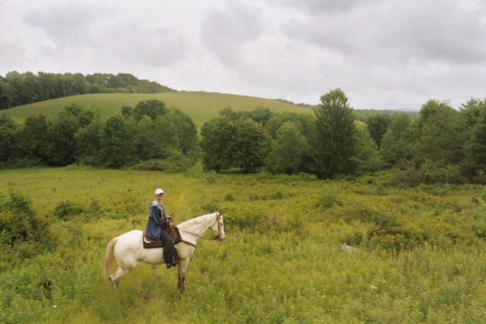
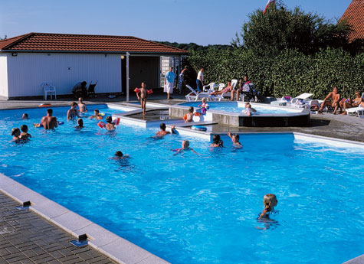
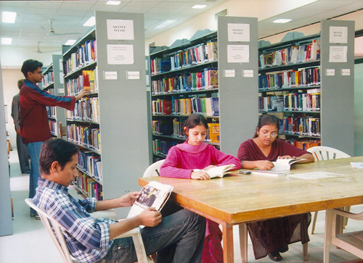
Yo VOY A IR al / a la… …..

Slide 11
Yo VOY A IR al / a la… PARA..(verb in infinitive) Yo voy a ir a la escuela PARA aprender.
I am going to go to school (in order) to learn.

