Slide 1
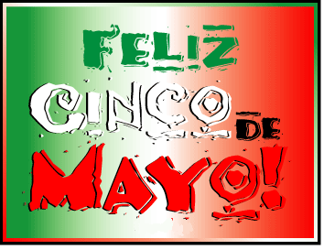
TRUE or FALSE:
Cinco de Mayo celebrates Mexico’s Independence?

Slide 2
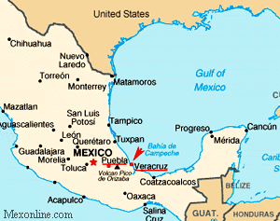
FALSE ! : Many people think that Cinco de Mayo is Mexico’s Independence Day, but Mexico gained independence from Spain on September 16th, 1821.
May 5th actually celebrates the Victory of the Mexican militia over the French army in the Battle of Puebla which happened in 1862.

Slide 3
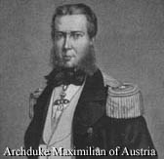
Between gaining independence from Spain in a bloody war and prior to the battle at Puebla, Mexico also suffered other internal political takeovers, the Mexican-American War (1846-1848) and the Mexican Civil War of 1858. Throughout this time, Mexico accumulated debts to many other countries and all wanted their money back, including France.
France also wanted to have leadership in Mexico and to expand it’s empire in Mexico. When Mexico stopped paying its loans, France installed the Archduke Maximilian of Austria as a ruler of Mexico.

Slide 4
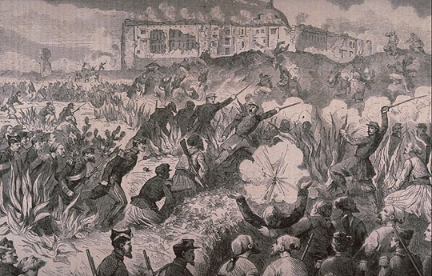
France invaded at the gulf coast of and began to march toward Mexico City where the French army encountered strong resistance near Puebla. In contrast to the French army of 6,500 men, the Mexican leader, General Ignacio Zaragoza Seguin, commanded a smaller militia of about 4,500. These poorly armed men were able to defeat a well outfitted French army and thereby halted France’s invasion of Mexico.
The victory was a much needed boost to Mexico and helped solidify national unity. That is the reason for the Cinco de Mayo celebration!

Slide 5
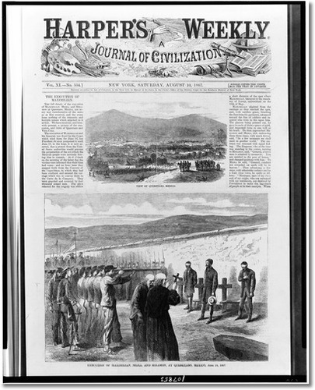
Unfortunately the good times did not last long. France sent more troops overseas to try and invade Mexico again. A year later, with more than 30,000 soldiers, the French took over Mexico City and installed Maximilian as the ruler of Mexico.
But we all know about Karma..
What goes around, comes around…
Maximilian’s rule of Mexico lasted only 3 years (1864-1867). The U.S. (with it’s own Civil War behind it) provided help to Mexico to expel the French and Maximilian was executed by the Mexicans.
View of Queretaro, Mexico--Execution of Maximilian, Mejia, and Miramon at Queretaro, Mexico | Print
Date Created/Published: 1867.

Slide 6
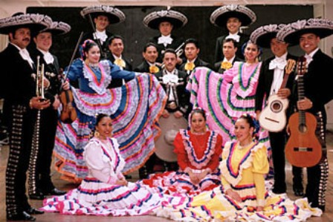
Believe it or not, Cinco de Mayo it is not a major holiday in Mexico. Rather it is mostly in the state capital city of Puebla and through out the state of Puebla, but in the rest of the country.
Even more interesting is the fact that Cinco de Mayo has become a bigger celebration north of the border in the U.S. than it is to the south in its country of origin. In the border cities of the United States the holiday is a celebration of Mexican culture, of food, music, beverage and customs unique to Mexico and commercial interests here and in Mexico help promote the holiday.

