Slide 1
Repaso del presente progresivo:
El verbo auxiliar (estar) + el participio presente (-ing in English)
-ando
-iendo
Gritar
Esconder
Subir

Slide 2
Do you remember the IRREGULAR present participles of the following verbs?
Oír
Leer
Creer
Destruir
Caer

Slide 3
Oír - oyendo
Leer - leyendo
Creer – creyendo
Destruir - destruyendo
Caer – cayendo
If these followed the REGULAR pattern for forming participles, we´d have 3 vowels in a row !

Slide 4
Repaso del pretérito:
AR: ER/IR:
é í
aste íste
ó ió
amos imos
astéis istéis
aron ieron

Slide 5
We have studied many TOTALLY irregular preterite verbs.
There are also groups of verbs that have changes ONLY in the
él, ella, Ud. and ellos, ellas, Uds. forms.
Let´s look at these verbs: oír, leer, creer, destruir ,caer
The irregularity that they had in the present participle
continues into the preterite. Try to fill in the two blanks.
Oír
Oí
Oíste
_____
Oímos
Oísteis
_____

Slide 6
Oír
Oí
Oíste
Oyó
Oímos
Oísteis
Oyeron
Now try these:
Leer creer destruir caer

Slide 7
Leer creer destruir caer
leí creí destruí caí
leíste creíste destruiste caíste
leyó creyó destruyó cayó
leímos creímos destruimos caímos
leísteis creísteis destruisteis caísteis
leyeron creyeron destruyeron cayeron
*destruir does not have the accents in the tú, nosotros, vosotros forms.

Slide 8
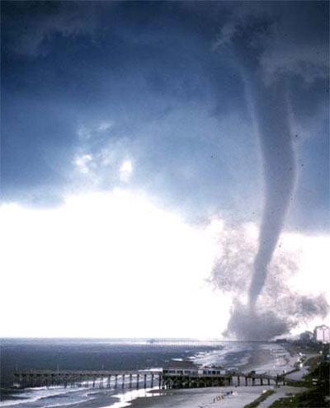
¿Qué creyó el reportero de ….?
It destroyed a city.
Many people escaped in a hurry.
The wind was strong.

Slide 9
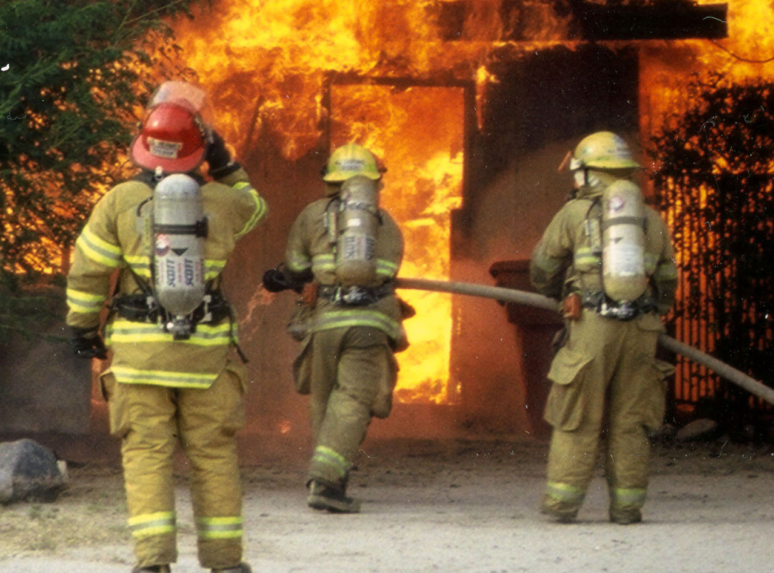
¿Qué leyó tu padre del ….?
The firemen put out the fire.
The paramedics saved many people.
There was a lot of smoke.
Many people escaped.

Slide 10
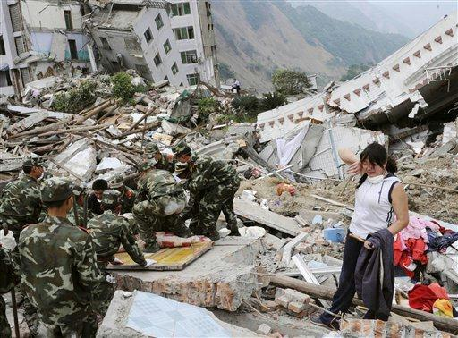
¿Qué creyó los paramédicos de ….?
Many buildings fell down.
It occurred suddenly.
It destroyed many homes.
They rescued many injured people.

Slide 11
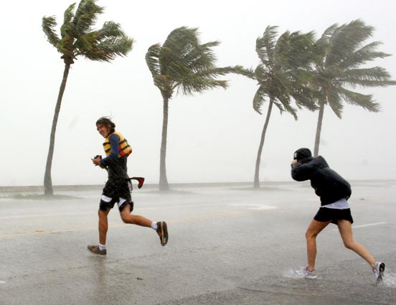
¿ Qué(se)cayó durante la….?
The rain fell.
Many trees fell down.
The people fell down when
they tried to run.

